Slide 1
Machine Learning - CLustering
UnSupervised Learning
Groups Similar Datapoints into based on inherit patterns and similarities
Groupings can be done within data not from external
Distance or Similarity between the datapoints calculated
User Defined Library can be modified at runtime also by using Virtual Environment

Slide 2
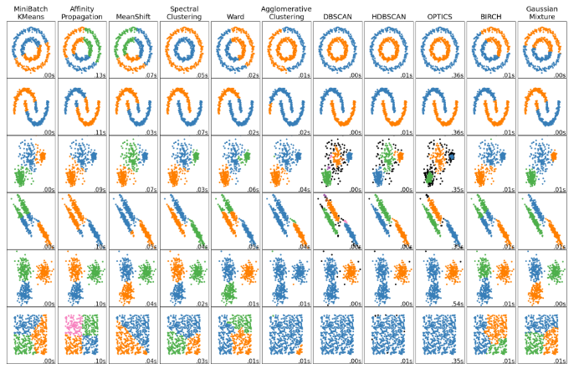
Machine Learning – Clustering - Methods
K-Means
Affinity Propogation
Mean-Shift
Spectral Clustering
Hierarchical Clustering
DBSCAN
HDBSCAN
OPTICS
BIRCH

Slide 3
Clustering Evaluation metrics
1. Rand index
2. Mutual Information based scores
3. Homogeneity, completeness and V-measure
4. Fowlkes-Mallows scores
5. Silhouette Coefficient
6. Calinski-Harabasz Index
7. Davies-Bouldin Index
8. Contingency Matrix
9. Pair Confusion Matrix

Slide 4
K-Means CLustering
Similarity based grouping
With Inertia concept, samples are separated into n groups of equal variance
Euclidean distance used for measuring distance
Random Centroids or Mean is calculated
Each Item categorized with near centroid by iterating all dataset

Slide 5
K-Means CLustering
Functionalities:
Choose Initial Centroids
Assigns each samples to its nearest centroids
Looping

Slide 6
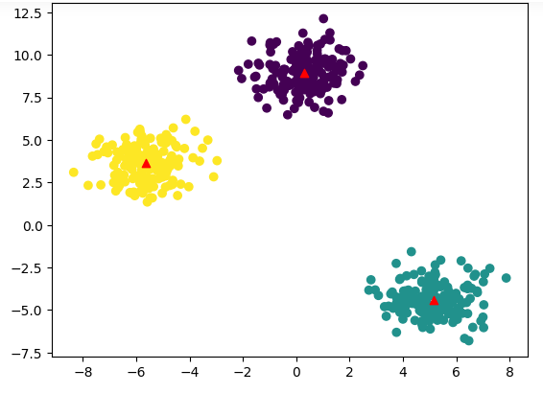
K-Means CLustering
Diagram shows the dataset plots as cluster
Red Mark is the Centroid of each cluster

